Slide 1

BHILAI INSTITUTE OF TECHNOLOGY, DURG
TITLE: E-WASTE FACILITY LOCATOR
Group No. — 15
Student’s Name: Guided by:
OJASWAT DIXIT
SURAJ KUMAR VERMA
VIKAS DEWANGAN
SHAILJA TRIPATHI

Slide 2
PROJECT INTRODUCTION
Electronic waste or e-waste describes discarded electrical or electronic devices. Growth in the IT and communication sectors has enhanced the usage of the electronic equipment exponentially. Faster upgradation of electronic product is forcing consumers to discard old electronic products very quickly.
Keeping all these problems in mind ,we have created this website . Firstly the website will have a user –friendly interface where individuals can enter their location or allow the website to access their location data.
Secondly ,users can input information about their old electronic devices , including the model and condition. The platform will calculate and display the estimated value of precious metals and other recyclable materials that can be recovered from the device.
And the last section ,the platform would offer educational pop-ups ,articles , or videos that inform users about the harmful components of electronic waste , such as heavy metals , toxic chemicals, and their adverse effects on the environment and human health.

Slide 3
PROBLEM STATEMENT
Our proposed project addresses a critical issue that affects both the environment and public health: electronic waste, or e-waste, is a growing problem globally. With the increasing pace of technological advancement, the disposal of outdated electronic devices has become a pressing concern. The improper disposal of e-waste can lead to hazardous materials leaching into the environment and, consequently, detrimental effects on ecosystems and human health. To tackle this challenge, we propose the development of an innovative online platform that serves as a comprehensive solution for e-waste collection, recycling, and education.

Slide 4
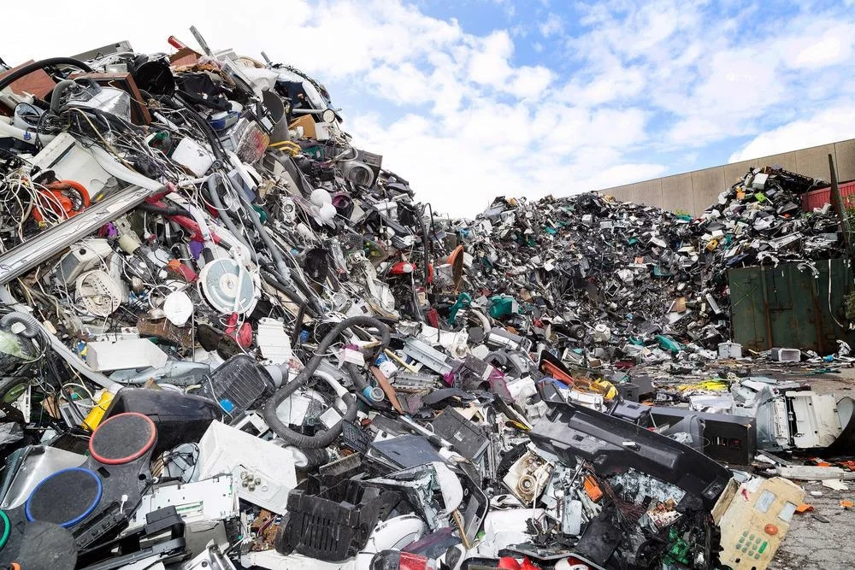
THE E-WASTE EPIDEMIC
Environmental Impact
Resource Recovery
Health Risk
Legislation and Responsible Disposal
India is a 3rd largest E-Waste producer
There are only 519 E-Waste facility

Slide 5
OBJECTIVE
To provide easy and convenient way for individuals to dispose of their old electronic devices responsibly.
It helps in significant contribution towards reducing the environmental impact of improperly disposed electronic devices.
Displays the estimated value of precious metals and recyclable materials that can be recovered from old devices.
To provide informative content on harmful and reusable components of e-waste and their effects on the environment and human health

Slide 6
E–WASTE AWARENESS
1.Token Incentive: Participants receive tokens for every piece of e-waste they recycle, which can be redeemed for various rewards.
2.Certificates of Achievement: Participants are awarded certificates recognizing their eco-friendly efforts, fostering a sense of accomplishment.
3.Incentivizing Recycling: Tokens can be exchanged for a range of goodies, encouraging more people to recycle their electronic devices.
4.Community Engagement: The program fosters a sense of community as individuals work together to protect the environment.
5.Long-term Impact: The initiative ultimately contributes to a greener future by encouraging responsible e-waste disposal and promoting sustainable consumption practices.

Slide 7
OUR INNOVATIVE SOLUTION
E- Waste Collection and Recycling Locator : A user friendly platform to help individuals locate nearby e-waste collection and recycling facilities , promoting responsible disposal.
Know Our Product(Estimating Value): Users can input details about their old electronic devices ,and the platform calculates the estimated value of recoverable materials, providing an incentive for recycling.
Credit Score and Incentives :Users earn credit points based on the estimated value of their e-waste, which can be redeemed for discounts, donations ,or cashback incentives.
Emphasis on Responsible E-Waste Disposal : Educational content informs users about the harmful components of e-waste and its impact on the environment and health, raising awareness.

Slide 8



SOFTWARE AND HARDWARE REQUIREMENT
Minimum 4GB of RAM & 20 GB of HDD
2. Minimum processor required Pentium, Intel x86_64.
3. Operating System : minimum window-7(64-bit)
4. HTML , CSS, JAVASCRIPT , mongoDB , nodeJS.

Slide 9
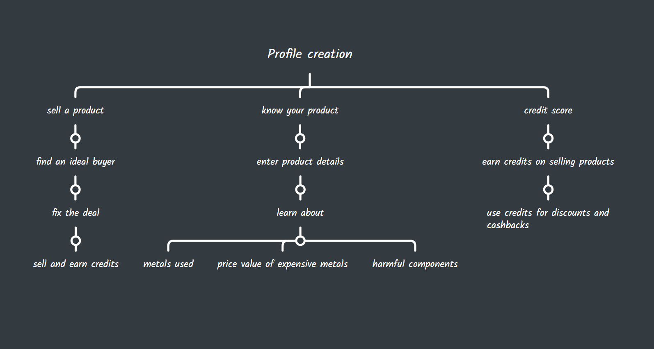

Slide 10
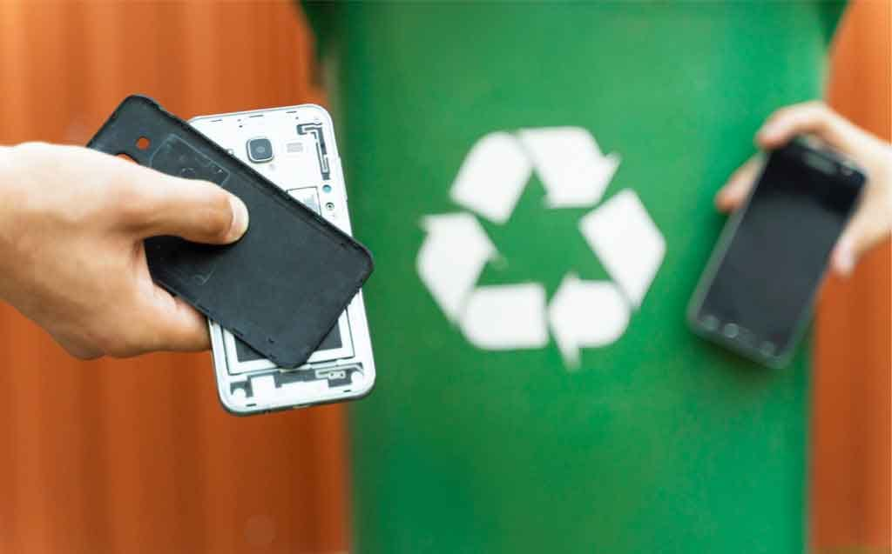
CONCLUSION
Environmental Impact
Financial Incentives
Challenges Acknowledged
Dependence on Technology

Slide 11
REFERENCES
ChatGPT: https://chat.openai.com
Google: https://www.google.com
Central Pollution Control Board – https://www.cpcb.nic.in

Slide 12


